Slide 1

Does Science Support “Support?”
John P. Hussman, Ph.D.
Summer 2014
Institute on Communication and Inclusion

Slide 2
“When I was growing up, speaking was so frustrating. I could see the words in my brain, but then I realized that making my mouth move [was needed to] get those letters to come alive, they died as soon as they were born. What made me feel angry was to know that I knew exactly what I was to say and my brain was retreating in defeat.”
- Jamie Burke

Slide 3
“As far as being able to do things after they were shown to me ahead of time, I could not repeat an action simply by having seen it. I could make a picture of it in my head, but I could not put it physically into motion. I could not [execute] my actions as I saw them in my mind, and consequently, I ended up withdrawing from actions.”
- Alberto Frugone

Slide 4
“There are times when I can’t do what I want to, or what I have to. It doesn’t mean I don’t want to do it. I just can’t get it all together somehow. Even performing one straightforward task, I can’t get started as smoothly as you can. Here’s how I have to go about things:
1) I think about what I’m going to do.
2) I visualize how I’m going to do it.
3) I encourage myself to get going…
There are times when I can’t act, even though I really, badly want to.”
– Naoki Higashida

Slide 5
Key Points
Many of the challenges in autism appear related to praxis, not global dysfunction.
Praxis is closely related to long-range neuroconnectivity, which is reduced in autism
Local connections between the motor cortex and the somatosensory cortex allow us to “play to the strengths” of individuals with autism by increasing proprioceptive/motor feedback.
Intention
Action
Ideation
Execution

Slide 6
1) Defining “Support”
FC / Supported Typing: A means of alternative and augmentative communication supported by a communication partner
Involves expression through pointing; using pictures, letters, objects, and most commonly by typing
Communication partner may provide:
  emotional encouragement
  communication supports; monitoring eye gaze,
  checking for typographical errors
  physical supports; slowing and stabilizing movement, inhibiting impulsive pointing, encouraging initiation
The facilitator does not provide expressive content
The facilitator should never move or lead the person
Goal is to fade support and encourage independence

Slide 7
Early Studies
Significant literature in early 1990’s generally refuting the validity of facilitated communication.
Subjects invariably had no prior history of literacy instruction.
Facilitators typically had no prior experience with the approach, and the first experience of the subjects was during the study itself (Eberlin 1993, Smith 1994)
Typically involved single-day, single-session testing.
Subjects were often pointing without looking at the letter board (Wheeler 1993)
Cardinal et al (1996) reported more favorable findings based on a significantly larger trial sample and longer study design.
There is an essential distinction between best practice and bad practice. Early claims of immediate literacy and expression using FC have little basis in existing research. However, more than a decade later, a growing number of individuals with ASD demonstrate independent communication, suggesting support as a strategy to teach literacy and expressive skill. This is why FC is often termed Facilitated Communication training.

Slide 8
Key presumptions behind “support”
Competence
  Capacity for complex thought and expression
  Intelligence, possibly not captured or reflected through standard testing practices
Movement Differences
  Apraxia / Dyspraxia
    inability to perform a task or movement, even though the task is understood;
    difficulty translating intention into action
  Qualitative factors: impulsive, repetitive, tremor
These are not unrelated factors …

Slide 9
“Intelligence” and Movement
Robust correlation between measures of motor function and measures of intelligence on standard tests (Wuang 2008, Green 2009, Vuijk 2010, Hartman 2010)
Tests necessarily rely on verbal or gestural skills
Individuals with ASD show discrepantly higher performance on tests of fluid intelligence and processing speed (thinking and reasoning) versus standard IQ tests (WISC) (Scheuffgen 2000, Dawson 2007, Wallace 2009)
However, tests of fluid intelligence are not correlated with “crystallized intelligence,” which is based on accumulation of facts and experience (Osmon & Johnson 2002).
Measured “IQ” is a better correlate of motor function, praxis, and fact accumulation than of general thinking, reasoning or processing ability.

Slide 10
Motor Function and Praxis
Motor difficulties are often the earliest observable signs of autism (Mostofsky 2009, Teitelbaum 2004, Landa 2006, Chawarska 2007)
Motor skills at age 2 are highly correlated with later outcome measures (Sutera, 2007)
Praxis in children with autism is strongly correlated with social, communicative and behavioral characteristics; significantly correlated with ADOS-G score (Dziuk, 2010)
Notably, this correlation with praxis remains significant even after controlling for basic motor skill (Dowell, 2009, Dziuk, 2010).

Slide 11
What is Praxis?
Performance of skilled, goal-directed motor behaviors that reflects motor execution but also relies on internal “action models” (Mostofsky, 2011)
Involves “ideation” of movement formulas and sequences that conceptualize what to do, as well as motor planning and execution (Baranek, 2005)
Requires basic motor skill, knowledge of representations of the movement, and translation of these representations into movement plans (Dowell, 2009)
“Dyspraxia may be a core feature of autism”
(Dziuk, 2010)

Slide 12
2) “Central processing” theories of autism
Executive Function
  “Higher order” control processes necessary to guide behavior, including planning, working memory, mental flexibility, impulse and response control, and monitoring of action (Jurardo & Rosselli 2007).
Weak Central Coherence
  A cognitive tendency to process information piecemeal, focusing on details rather than global features (Frith, 1989)
Mirror Neuron Deficit / Theory of Mind:
  Observing actions of others selectively activates neural circuits that are used to produce the same actions directly. Indirect measurement (mu suppression) suggests inactivity in autism (Dapretto, 2006).
  Commonly used to justify a presumed “lack of empathy” and “deficit in understanding the intentions of others”

Slide 13
Core Deficit or Improvable Symptom?
“Treating executive function as a global explanation of autism may mistake difference and difficulty for incapacity. Is the person who struggles with a particular task… really missing a cognitive mechanism?” (Biklen, 2005)
Weak central coherence is conceptual - postulates an unidentified “core deficit in central processing” that may be better explained by reduced communication between distributed brain regions (Just et al, 2004)
Impairments in imitation skills should not be cited as evidence for a mirror system deficit – no difference between performance on imitative tasks versus non-imitative tasks (Leighton, 2008)

Slide 14
Kernel of Truth
Activation of the frontal cortex is associated with a wide range of functions including switching of attention and maintaining higher order control (Solomon 2009). We associate these with “executive function.”
Mirror neuron system largely overlaps praxis systems, relying both on posterior regions necessary for storage of movement formulas (action models) and premotor regions necessary to sequence them (Mostofsky and Ewen, 2001)
Difficulties in autism suggest greater difficulty coordinating long-range signals between frontal and posterior areas of the brain.
Reduced “mirror system” activation may not imply failure to understand intention, experience empathy, or form action models, but instead may reflect difficulty in praxis – in particular, a tendency to execute actions as component parts rather than chaining them into an integrated sequence.

Slide 15

“To learn the technique of moving my right hand needed control over the ball and socket joint of the shoulder and then the hinge joint of my elbow and finally fold the other fingers and keep the point finger out. After that, focusing on the object which matched the word”
– Tito Mukhopadhyay
Quoted from Biklen (2005) Autism and the Myth of the Person Alone
“It is hot; we should open the window… I can describe the action: I must push the button with my finger. But my hesitation grows while I try to put the sequences to go through the action. I mentally review the necessary steps, but the first one simply doesn’t come out. I’m trapped. To help the child with autism, verbally give me the sequences and facilitate me while I try to organize myself.” - Alberto Frugone

Slide 16
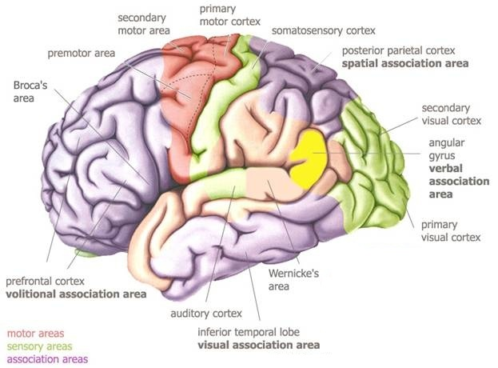
3) The landscape of the brain

Slide 17
Frontal Cortex
General: Cortex is the surface of the lobe, about 1/8 inch thick – “grey matter”
Involved in conscious control, strategic control, volitional control, switching attention, error processing
Prefrontal cortex: appears to function as a “pointer” to features that belong together (e.g. verbal, spatial features of words)
Premotor/Motor cortex: Selects motor “formulas,” translates them into action plans, and initiates movement by transmitting motor commands to spinal cord and muscles. Also involved in planning and executing speech, but not uniquely.

Slide 18
Parietal Cortex
Associated with the storage of motor programs (movement “formulas”), integration of spatial information, and body configuration (“schema”)
Includes somatosensory cortex: Integrates internal sensory information from the body such as movement, position, pressure, and temperature. Associated with “proprioceptive” feedback. Adjacent to the motor cortex, relying on short-range connections.
Sometimes called the “where” cortex.

Slide 19
Temporal and Occipital Cortices
Temporal: Associated with auditory (hearing) and association (memory) function.
Left temporal region is particularly associated with speech, language, comprehension, and verbal naming,
Occcipital: Associated with imagery and integration of visual information.

Slide 20
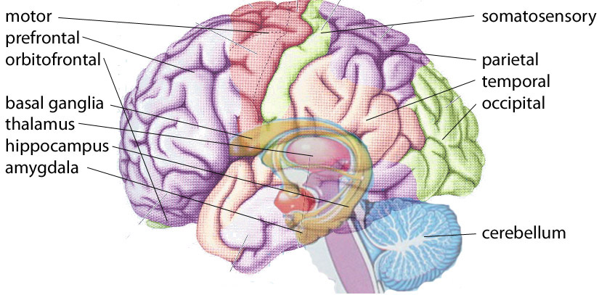
Circuitry is not always direct
Thalamic relay (integrates with sensory inputs)
Cortex -Cerebellum-Thalamus-Cortex (unconscious planned movement)

Slide 21
4) Altered Connectivity in Autism
Difficulties in social interaction, language and behaviors in autism “arise because these are the domains that place the largest demands on the time-sensitive integration of information from spatially discrete areas of the brain” (Wass 2011)
Views these difficulties as non-localized: an “emergent property of the collaboration among brain centers” rather than a “core deficit.” (Just et al., 2004)

Slide 22
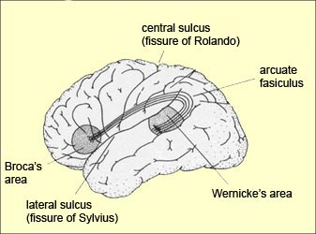
Frontal-Parietal Connectivity
Both imitation and praxis depend on circuits necessary for “action model” formation – specifically connectivity between posterior parietal regions that form and store spatial representations, and premotor regions necessary to select and sequence the resulting programs (Mostofsky & Ewen 2011)
Speech and language function involves cooperation between the frontal lobe (Broca’s area – speech production) and temporal-parietal regions (Wernicke’s area – processing and understanding of language input). These are connected by long-range connections called the arculate fasciculus.

Slide 23
Difficulty executing “action chains”
Individuals with ASD appear to experience a gap between intended motor plans (parietal “action chains”) and the execution of those motor plans.
Fabbri-Destro (2009): difficulty “chaining motor acts into a global action”
Cattaneo et al (2007): Typically, frontal-parietal action chains trigger muscle activation at the very outset of an action. In ASD, no activation of mouth-opening muscles when grasping to eat until food immediately approached the mouth.

Slide 24
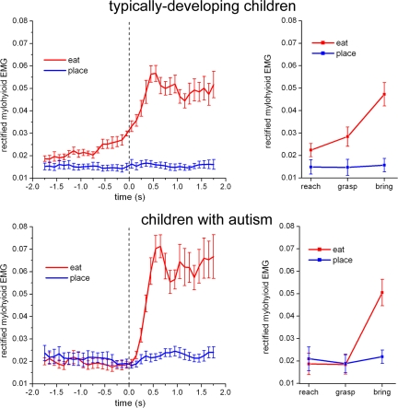

Slide 25
a) Neuroanatomical evidence
Abundance of short connective fibers in frontal and temporal regions, relative to long-range connections (Casanova et al, 2002)
Decrease in the largest axons that communicate over long distances and excessive connections between neighboring areas (Zikopoulos & Barbas, 2010)
Increased volume of radiate white matter (Herbert, 2004), particularly comprised of abundant short fibers in the primary motor cortex, which is a robust predictor of deficits in motor skill (Mostofsky et al., 2007).
Reduced thickness of corpus callosum in ASD relative to matched controls (Just et al, 2004).
Note that communication between regions is also affected by factors such as neurotransmitter function and “microarchitecture” – not limited to fiber tracts.

Slide 26
b) Functional Connectivity Studies
Use fMRI and related tools to measure the synchronization (correlation) of activation between different brain regions when performing various tasks.
Individuals with ASD exhibit reduced frontal-parietal connectivity (Just et al, 2004, Solomon 2009, Mostofsky & Ewen 2011).
Individuals who spontaneously recover language after stroke show increased fronto-parietal integration (Sharp, 2009)
High-resolution (dynamic) coherence shows reduced long-range connections in ASD in frontal-occipital connections, and increased short-range connections in lateral-frontal connections, with differences correlated with ASD severity (Barttfeld et al, 2010).
Children with ASD show less activation in the cerebellum (unconscious planned movements) with relatively more fronto-striatal activation, associated with increased need for conscious execution of planned movements (Mostofsky et al, 2009)

Slide 28
c) Genetic evidence
Genes associated with autism show significant enrichment in pathways that regulate the neuronal cytoskeleton and the outgrowth and guidance of axons and dendrites. Additional role implicated for excitatory/inhibitory transmission and GABAergic interneuron development (Hussman et al, 2011)
The set of genes most correlated to neuroanatomic connectivity (in adult rodent brain) are enriched for genes involved in neuronal development and axon guidance. Numerous high-confidence connectivity genes overlap genes implicated in autism (French & Pavlidis, 2011)
Example - Common variants in the autism risk gene CNTNAP2 are associated with altered functional connectivity in frontal lobe circuits in humans (Scott-VanZeeland et al, 2010)

Slide 29
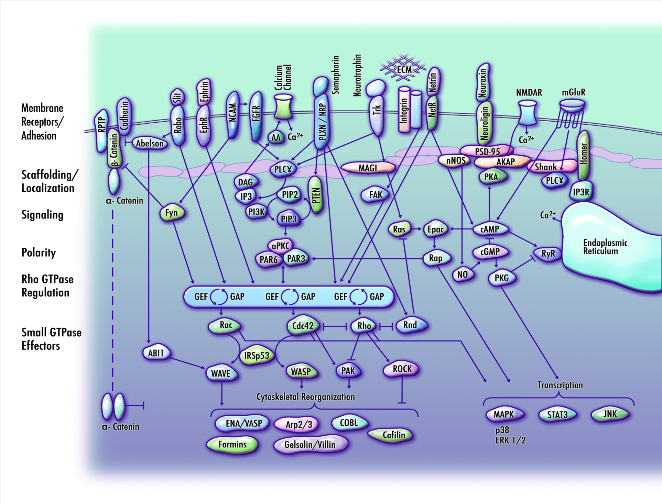

Slide 30
5) Strategies - Playing to Strengths
The formation of action models through proprioceptive feedback can rely on short-range connections between the adjacent somatosensory and motor cortices, while action models are less reliant on visual feedback in ASD (Mostofsky & Ewen, 2011)
Learning novel movements is more strongly reliant on proprioceptive feedback in autism (Haswell et al, 2009)
Despite motor and sensory challenges, proprioceptive input appears intact in ASD (Fuentes et al, 2010)
During sentence comprehension, ASD individuals activated parietal and occipital brain areas (adjacent to Wernicke’s area) for both low- and high-imagery sentences, suggesting they were using mental imagery in both conditions (Kana et al, 2006)
Suggests the use of local connectivity (proprioceptive input for action, visualization for comprehension) to compensate for long-range connectivity.

Slide 31
a) Haptic feedback (“force feedback”)
The use of the sense of touch by applying force, resistance or other motion to provide proprioceptive feedback to the user
In conjunction with visual feedback, haptic training may be an effective tool for teaching sensorimotor skills that have a force-sensitive component to them (Morris, 2007)
Haptic feedback facilitates decoding of motor imagery, and “closing the sensorimotor loop” (Gomez-Rodgriquez et al, 2011)
Individuals with ASD have difficulty improving accuracy by slowing down impulsive responses after making an error (Sokhadze, 2010)

Slide 32
Warning! Guidance is not “feedback”
While haptic guidance reduces execution errors, it significantly reduces the rate of learning, so performance degrades over the course of a few unassisted trials (Liu 2006, van Asseldonk 2009)
Performance errors drive motor learning. For less skilled subjects, haptic guidance may be beneficial, but once basic skill is obtained, guidance is counterproductive and adapting the difficulty of the task accelerates motor learning (Milot 2010, Dosen 2010, Emken & Reinkesmeyer 2005)
Heavily guided practice is detrimental to learning, regardless of frequency. With autism, guidance should emphasize gradual withdrawal of direct input (Larin 1998)
Beyond development of basic pointing skill, typing “support” should not be provided as guidance, but as feedback and backward resistance, gradually fading toward independence.

Slide 33
b) Modeling
In skills training for children with developmental delays, the passive observation of a model demonstrating the target skill is more effective than hand-over-hand instruction. The instructor should intervene as little as possible and without vigorous prompting (Biederman et al, 1998)
With low-skilled subjects, peer-modeling – watching a relatively unskilled person learning a motor skill – is more effective than instructor modeling (Larin, 1998)

Slide 34
“I must picture actions before doing them. Picture = to visually represent them in my mind. It is efficacious for me to observe someone performing an action and then I can try to do it but with facilitation. It’s necessary for me to gain real experience.”
- Alberto Frugone

Slide 35
c) Cognitive skills and motor practice
Training of working memory is associated with increases in white matter structural integrity and connectivity (Takeuchi, 2010)
100 hours of intensive remedial instruction in reading increased the specific white matter structure that was previously impaired in these children, with white matter improvement correlated with reading improvement (Keller & Just, 2009)
Motor practice with non-dominant hand (even finger skills 5-2-4-3-5, 5-3-4-2-5) strengthens inter-regional connectivity, reflecting long-term motor plasticity (Ma 2010, Xiong 2009)
Learning and brain plasticity are activity-dependent.
Hebb’s Rule: synaptic connectivity changes as a result of repetitive firing.

Slide 36
d) Passive Touch
Action requires knowledge of our body location in space. Touch given prior to action affects the integration of visual and proprioceptive body location information. The brain uses cues from passive touch and vision to update its own position and to experience self-location (Zopf 2011)
Passive tactile input improves stability. If passive input about posture is available, postural control adapts to this input, producing stabilizing reactions (Rogers, 2001)

Slide 37
“Touch is always a big help when an activity is new for me. Only through practice and through the gradual fading of touch the activity can be done independently. I needed to be touched on my right shoulder for doing any new skill. So I consider that the touch method is a vital step to speed up my learning skill.”
Tito Mukhopadhyay
“I take mechanical steps alone, but if taken by the hand or the arm, I walk regularly.”
- Alberto Frugone

Slide 38
e) Physical prompting
1) Most-to-least prompting (MTL): Hand-over-hand guidance through the initial teaching. Gradually less intrusive prompting such as support at the wrist, then the upper arm, then the shoulder, then light touch, as skill is developed;
2) Most-to-least with time delay (MTLD): Begins with hand-over-hand guidance followed by less intrusive prompting as skill is developed, but before offering the less intrusive prompts, a time delay (e.g. 2 seconds) is provided to encourage independence. Any errors are immediately corrected by providing hand-over-hand assistance if necessary.
3) Least-to-most prompting (LTM): The person is given a brief opportunity to perform the action (often with a verbal prompt or an expectant look), followed by the least intrusive prompt that is needed. Gradually more intrusive prompting is provided if necessary.
The following guidelines are recommended as best practice (Libby et al, 2008):
MTLD appears to be the best default strategy when an individual’s learning history is unknown.
MTL or MTLD is preferred if errors tend to increase problem behavior or create other learning difficulties. Among these choices, MTL minimizes errors but may slow the acquisition of the skill.
LTM appears preferable if students have a history of rapidly learning skills with this method.

Slide 39
6) Best Practices
Proprioceptive feedback is provided through haptic resistance (“force feedback”) and passive touch – not by guiding movement.
Communication partner should be positioned to monitor eye gaze.
The objective is to make sensorimotor feedback available to help the user to organize, control and self-initiate motor execution - not to initiate for the user.
Think – look – type : Encourage mental planning and visual imagery prior to movement
Instructor or peer-modeling should be included as an alternative to hand-over-hand instruction if the partner demonstrates strong imitative skill.
Follow the lead! Focus on topics of intense interest and relevance to the communication partner.
Training should include standard elements of literacy: spelling, reading instruction, sentence construction, grammar, etc.

Slide 40
6) Best Practices (continued)
Cognitive skills training (memory, recall games) and motor practice (finger tapping, cup stacking) can be included to enhance activity-dependent connectivity.
Integrate as many sensory inputs (touch, sound, visual) as possible to reduce the reliance on any single sensory channel.
Don’t over-interpret unreliable communication. Recognize the potential for small errors to dramatically influence meaning.
If ever in doubt, there is nothing wrong with saying “I’m not sure whether that was me or you, can you try saying that in a different way?”
Instruction in all disciplines (math, science, literature, history) is the basis of “crystallized intelligence,” which is often underdeveloped in autism due to lack of exposure to content.
Continually fade prompts and support to encourage independence.

Slide 41
“Education has inherent value to all people. Learning about mathematics, literature, science, history, philosophy and other disciplines gives any person depth of understanding and expands the soul. Why should any group of people be denied access to this precious gift because of a disability, regardless of the challenges that disability represents?
“It doesn't matter what the autistic person might ‘do’ with the education; they may never have an independent career requiring academic achievement, although one never knows. What matters is: who can the person with autism ‘be’ without a foundation of learning?”
Soma Mukhopadhyay
Quoted from Understanding Autism through Rapid Prompting Method (2008)

Slide 42
“The problem is not one of understanding, but of doing.”
Doug Biklen
“What the child is able to do in collaboration today, he will be able to do independently tomorrow.”
- Lev Vygotsky

Slide 43
References
Barttfeld et al (2010), A big-world network in ASD: Dynamical connectivity analysis reflects a deficit in long-range connections and an excess of short-range connections
Biederman et al (1998), Teaching basic skills to children with Down syndrome and developmental delays: the relative efficacy of interactive modeling with social rewards for benchmark achievements and passive observation
Biklen (2005), Autism and the Myth of the Person Alone
Cardinal et al (2006), Investigation of authorship in facilitated communication
Casanova et al (2002), Neuronal density and architecture (Gray Level Index) in the brains of autistic patients
Cattaneo et al (2007), Impairment of actions chains in autism and its possible role in intention understanding
Chawarsaka et al (2007), Parental recognition of developmental problems in toddlers with autism spectrum disorders
Dawson et al (2007), The level and nature of autistic intelligence
Dosen et al (2010), Assistive forces for the acquisition of a motor skill
Dowell et al (2009), Associations of postural knowledge and basic motor skill with dyspraxia in autism - implications for abnormalities in distributed connectivity and motor learning
Dziuk et al. (2010), Dyspraxia in autism: association with motor, social, and communication deficits
Eberlin et al. (1993), Facilitated communication: a failure to replicate the phenomenon
Emken & Reinkensmeyer (2005), Robot-enhanced motor learning: accelerating internal model formation during locomotion by transient dynamic amplification
Fabbri-Destro et al (2009), Planning actions in autism
French & Pavlidis (2011), Relationships between gene expression and brain wiring in the adult rodent brain
Frith (1989), Autism: Explaining the Enigma
Fuentes et al (2010), No proprioceptive deficits in autism despite movement-related sensory and execution impairments
Gomez-Rodriguez et al. (2011), Closing the sensorimotor loop - haptic feedback facilitates decoding of motor imagery
Green et al (2009), Impairment of movement skills of children with autism spectrum disorders
Haswell et al (2009), Representation of internal models of action in the autistic brain
Hartman et al (2010), On the relationship between motor performance and executive functioning in children with intellectual disabilities
Hussman et al (2011), A noise-reduction GWAS implicates altered regulation of neurite outgrowth and guidance in autism
Just et al (2004), Cortical activation and synchronization during sentence comprehension in high-functioning autism: evidence of underconnectivity
Kana et al. (2006), Sentence comprehension in autism: thinking in pictures with decreased functional connectivity
Keller & Just (2009), Altering cortical connectivity: remediation-induced changes in the white matter of poor readers

Slide 44
Landa & Garrett-Mayer (2006), Development in infants with autism spectrum disorders: a prospective study
Larin (1998), Motor learning - a practical framework
Libby et al (2008), A comparison of most-to-least and least-to-most prompting on the acquisition of solitary play skills
Liu et al. (2006), Learning to perform a novel movement pattern using haptic guidance: comparison of haptic guidance and visual demonstration
Ma, Wang et al (2010), Motor learning and connectivity
Milot et al. (2010), Comparison of error-amplification and haptic-guidance training techniques for learning of a timing-based motor task by healthy individuals
Morris et al (2007), Haptic feedback enhances force skill learning
Mostofsky et al (2007), Increased motor cortex white matter volume predicts motor impairment in autism.
Mostofsky et al (2009), Decreased connectivity and cerebellar activity in autism during motor task performance
Mostofsky and Ewen (2011), Altered connectivity and action model formation in autism is autism
Mukhopadhyay (2008), Understanding Autism through Rapid Prompting Method
Robinson et al. (2009), Executive functions in children with autism spectrum disorders
Rogers et al (2001), Passive tactile sensory input improves stability during standing
Scheuffgen et al (2000), High "intelligence", Low "IQ"? Speed of processing and measured IQ in children with autism
Scott-VanZeeland et al (2010), Altered functional connectivity in frontal lobe circuits is associated with variation in the autism risk gene CNTNAP2
Sharp et al (2009), Increased frontoparietal integration after stroke and cognitive recovery
Smith et al (1994), Facilitated communication: the effects of facilitator knowledge and the level of assistance on output
Sokhadze et al (2010), Impaired error monitoring and correction function in autism
Solomon et al (2009), The neural substrates of cognitive control deficits in autism spectrum disorders
Sutera et al (2007), Predictors of optimal outcome in toddlers diagnosed with autism spectrum disorders
Takeuchi et al (2010), Training of working memory impacts structural connectivity
Teitelbaum et al (1998), Movement analysis in infancy may be useful for early diagnosis of autism
van Asseldonk et al (2009), Influence of haptic guidance in learning a novel visuomotor task
Vuijk et al (2010), Motor performance of children with mild intellectual disability and borderline intellectual functioning
Wallace et al (2009), Brief Report: information processing speed is intact in autism but not correlated with measured intelligence
Wass (2011), Distortions and Disconnections - disrupted brain connectivity in autism
Wheeler et al (1993), An experimental assessment of facilitated communication
Wuang et al (2008), Profiles and cognitive predictors of motor functions among early school-age children with mild intellectual disabilities
Xiong et al (2009), Long-term motor training induced changes in regional cerebral blood flow in both task and resting states
Zikopoulos and Barbas (2010), Changes in prefrontal axons may disrupt the network in autism
Zopf (2011), Viewing and feeling touch modulates hand position for reaching

